Slide 1

ST.ANN’S COLLEGE OF ENGINEERING & TECHNOLOGY
A Project report on
Alive Human Detection by Semi-autonomous
Mobile Rescue Robot
Under the esteemed guidance of
U.JAYA RAM M.E, MISTE, MIE
Assistant Professor
PRESENTED BY
S.BHARGAVA (14F01A04H9)
M.MANASA (14F01A04C3)
S.BABY (14F01A04G4)
SK.SAJID BASHA (14F01A04H6)

Slide 2
CONTENTS
ABSTRACT
Block Diagram
JOYSTICK Module
*Principle of Joystick Module
*Working of Joystick Module
PIR Sensor
*Principle of PIR Sensor
*Working of PIR Sensor
MQ 135 Gas Sensor
*Principle of Gas Sensor
*Working of Gas Sensor

Slide 3
ABSTRACT
Many times we observe that many people dies by trapping in disasters like earthquakes, but the people also dies on large scale just because they didn’t get help at instant time or the help provided to them is late.
This project propose an mobile robot based on Wireless Sensor Network (WSN) which is designed for human existence & detection in disasters. The main objective of this Project is to rescue more & more number of people from the adverse condition.

Slide 4
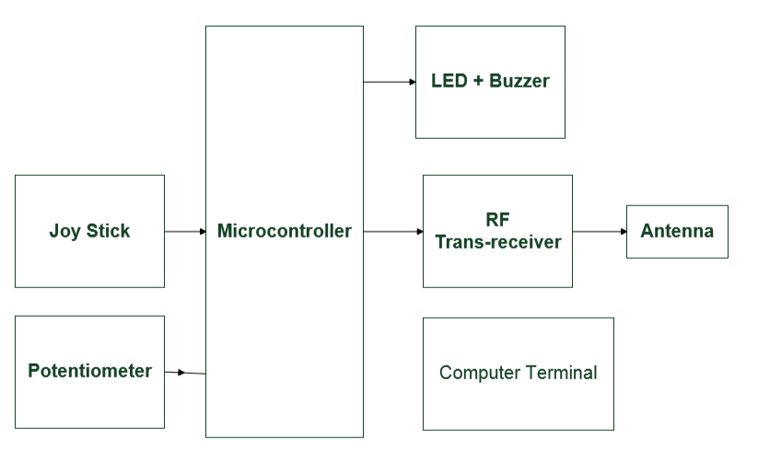
Block Diagram of Transmitter :

Slide 5
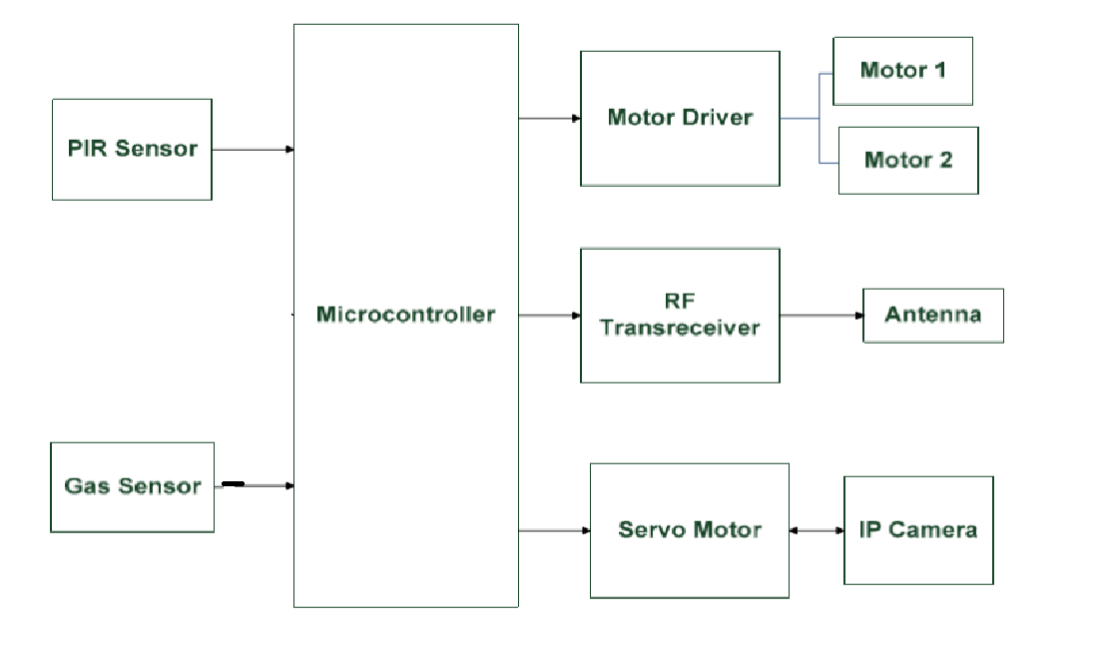
Block Diagram of Receiver :

Slide 6
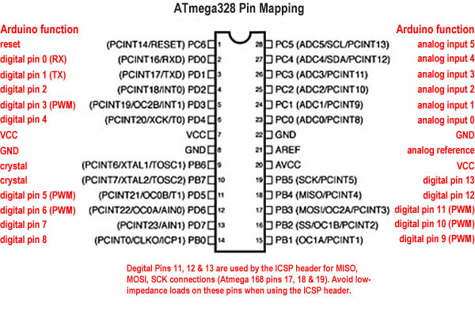
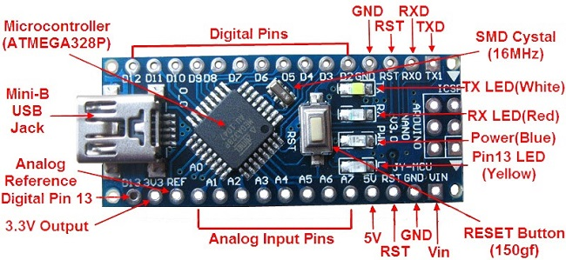
Arduino Pin Configuration

Slide 7
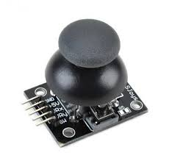
JOYSTICK MODULE
The X and Y axes are two 10k potentiometers which control 2D movement by generating analog signals.
The joystick also contains a tactile switch that can be triggered by pressing the thumbstick down that could be used for special applications.

Slide 8
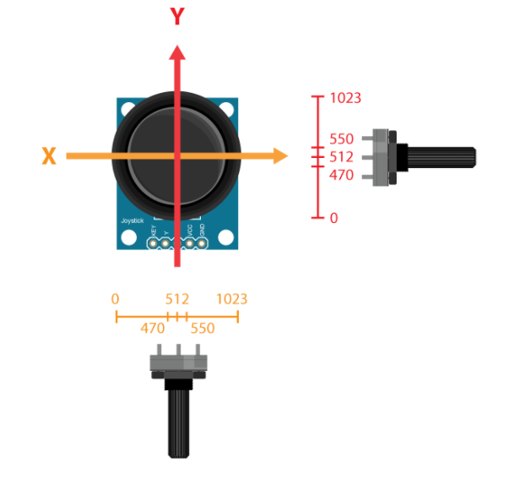
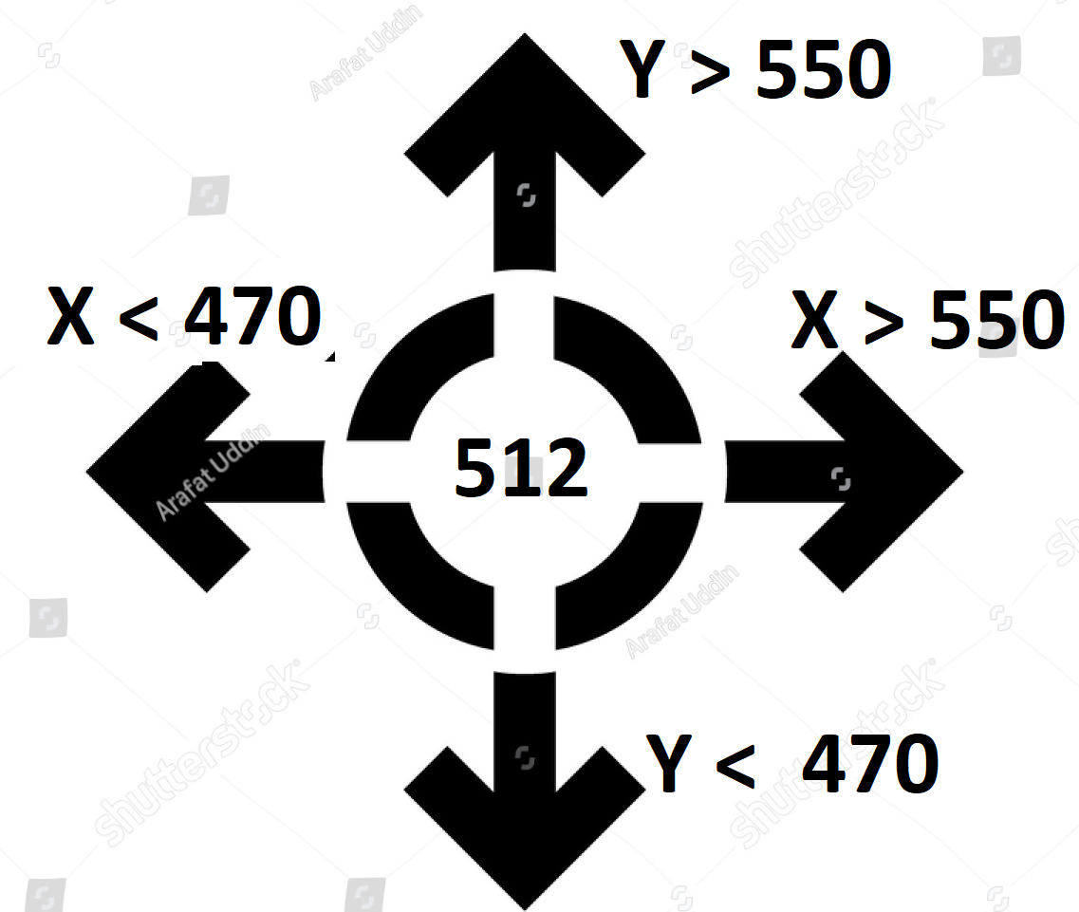
Principle of Joystick Module :
The joystick is actually made of two potentiometers they have values from 0 to 1023.
Directions using Joystick
Y > 550 & X = 0 – Forward
Y < 470 & X = 0 – Backward
X > 550 & Y = 0 – Right
X < 470 & Y = 0 – Forward

Slide 9
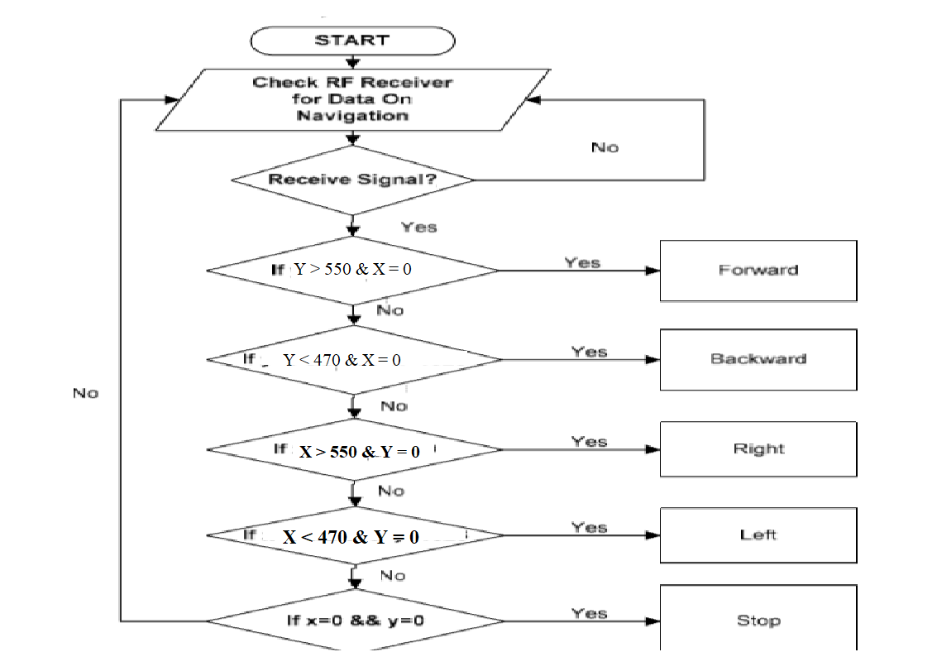
Flowchart: :
Working of Joystick Module :

Slide 10
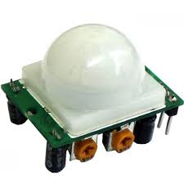
PASSIVE INFRARED SENSOR(PIR):
It is an electronic sensor that measures infrared light radiating from objects
It detects any signal it sends responds to the rescue team threw RF transceivers

Slide 11
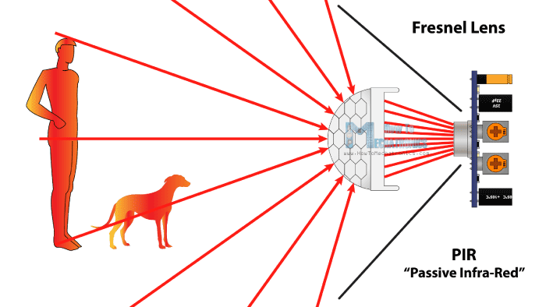
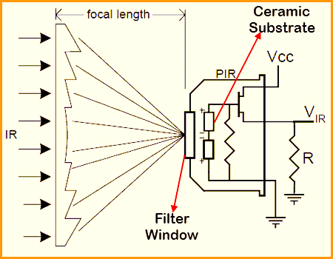
Principle of PIR Sensor
The PIR sensor itself has two slots in it, each slot is made of a special material that is sensitive to IR.
When a warm body like a human or animal passes by, it first intercepts one half of the PIR sensor, which causes a positive differential change between the two halves.

Slide 12
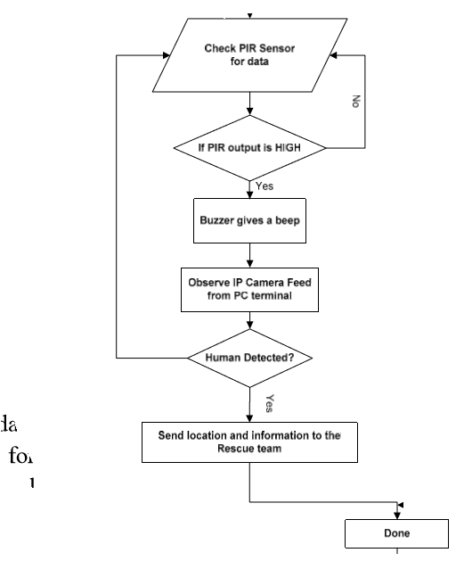
Working of PIR Sensor
Flowchart:

Slide 13
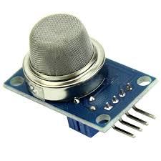
MQ 135 GAS sensor: A gas sensor or detector is a device that detects the presence of gases like poisonous gases in an area.

Slide 14
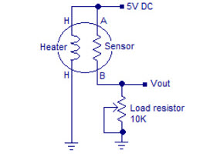
Principle of Gas Sensor
The MQ-135 alcohol sensor consists of a tin dioxide (SnO2), a perspective layer inside aluminium oxide micro tubes and a heating element inside a tubular casing.
it has lower conductivity compare to clean hair and due to air pollution the conductivity is increases

Slide 15
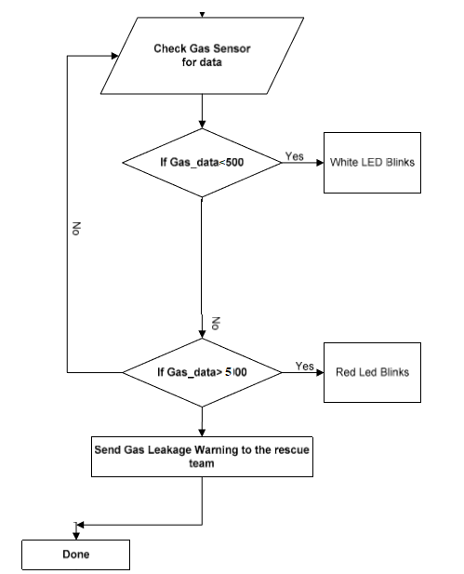
Working of Gas Sensor: Flowchart:

Slide 16
APPLICATIONS
In natural climatic situations.
In Train accidents.
In coal mines where poisonous gases are emitted.
In situations like attack of terrorists with Bomb blasts.

Slide 17


Slide 18


